Slide 1

INTERNSHIP REPORT
Name: Siddavatam Lakshmi Pranathi
Register Number: 192124046

Slide 2
TABLE OF CONTENTS
Introduction
Company Overview
Internship Objectives
Work Responsibilities
Challenges and Solutions
Skills Gained and Knowledge Acquired
Contribution to the Organization
Conclusion

Slide 3
INTRODUCTION
About me.
Purpose of the internship
Duration and location
I am Siddavatam Lakshmi Pranathi, a B.Tech student from the Department of Artificial Intelligence and Data Science.
To gain hands-on experience in Python development and SQL database management while contributing to real-time coding projects and mini-systems.
Interned at Hexaware Technologies Limited from 13th March 2025 to 29th May 2025. Internship was conducted in hybrid mode — with virtual mentorship and project execution from Hexaware Chennai Office.
.

Slide 4
COMPANY OVERVIEW
About the Organization.
Founded in 1990, Hexaware is a global IT services company with headquarters in Navi Mumbai. It specializes in automation, cloud, and data science services.
Services and Clients:
Provides IT consulting, cloud enablement, automation, AI, ERP, and BPO services for global clients including Fortune 500 companies across banking, healthcare, retail, and logistics.
The department I worked in.
I was assigned to the Coding & Automation Practice Unit, where I worked under the mentorship of Sudha (HR Coordinator). During my internship, I learned from several automation projects and gained valuable experience in coding and process optimization.

Slide 5
INTERNSHIP OBJECTIVES
Primary objectives of internship..
Hoped to achieve during the internship.
Strengthen Python coding and SQL proficiency through real-world mini-projects.
Develop backend logic and connect applications to relational databases.
Understand Agile methodology and team collaboration practices.
Build confidence in writing clean, modular code.
Prepare for roles like Python Developer or Data Analyst.
Gain familiarity with professional tools like Git, VS Code, and SQL Server.

Slide 6
WORK RESPONSIBILITIES
Projects I worked on or assisted with.
My main tasks and responsibilities.
Developed Python modules with database connectivity using `pyodbc`.
Designed and executed SQL queries for CRUD operations.
Used Git for version control and documentation of each module.
Participated in daily SME connects and weekly project reviews.
Hospital Management System
Library Management System
Crime Management Challenge
Order Management System
Visual Art Gallery Case Study

Slide 7
CHALLENGES AND SOLUTIONS
Challenges I faced during my internship.
Difficulty connecting Python to SQL Server (`pyodbc` config errors)..
Difficulty connecting Python to SQL Server (`pyodbc` config errors).
How I addressed or overcame them.
Referred to official documentation and online tutorials.
Used VS Code debugging tools and print statements.

Slide 8
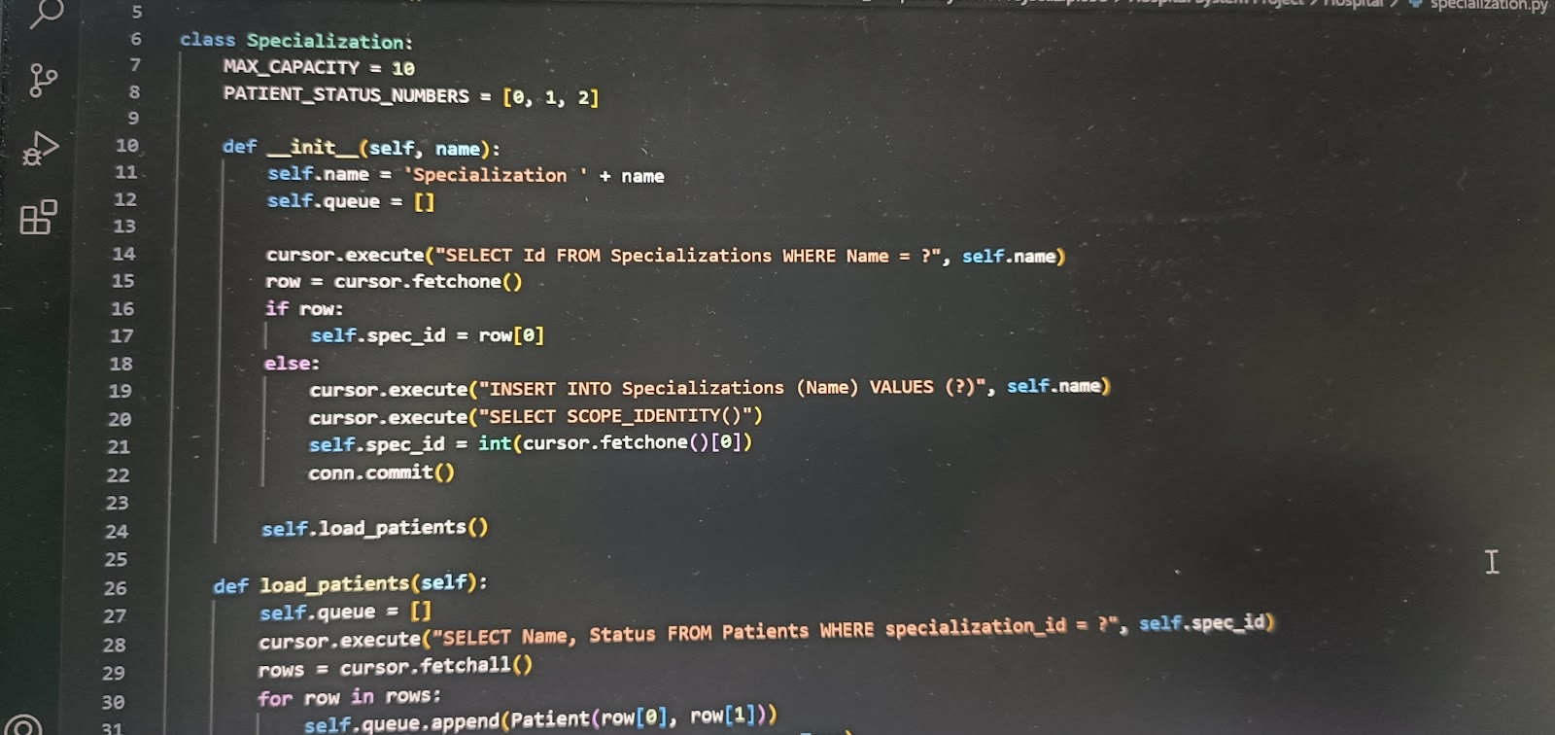
SKILLS GAINED AND KNOWLEDGE ACQUIRED
Tools, software, or methodologies I learned.
The professional and personal skills I developed.
Pictures if any..
Python, SQL Server, Visual Studio Code, Git
Internal LMS, Udemy resources
Agile project management practices.
Python 3 programming, exception handling, file structuring.
SQL query design, database schema creation, `pyodbc` integration.

Slide 9
CONTRIBUTION TO THE ORGANIZATION
How my work added value to the organization.
Feedback received from my supervisor or team.
Designing modular Python applications for real-world workflows.
Connecting apps to backend databases for real-time data handling.
Maintaining clean documentation and flowcharts for project review.
Praised for timely task completion and self-driven debugging.
Recognized for clear documentation and proactive code reviews.
Appreciated for collaborative attitude during peer discussions.

Slide 10
CONCLUSION
Summarization of internship experience.
Hexaware internship helped bridge the gap between classroom knowledge and industry practices. I learned to think like a developer, write scalable code, and manage project components end-to-end.
Reflect on how the internship aligned with my career goals.
This internship prepared me for roles such as:
Python Developer
Data Analyst
Junior Full Stack Developer (Foundation)

Slide 11
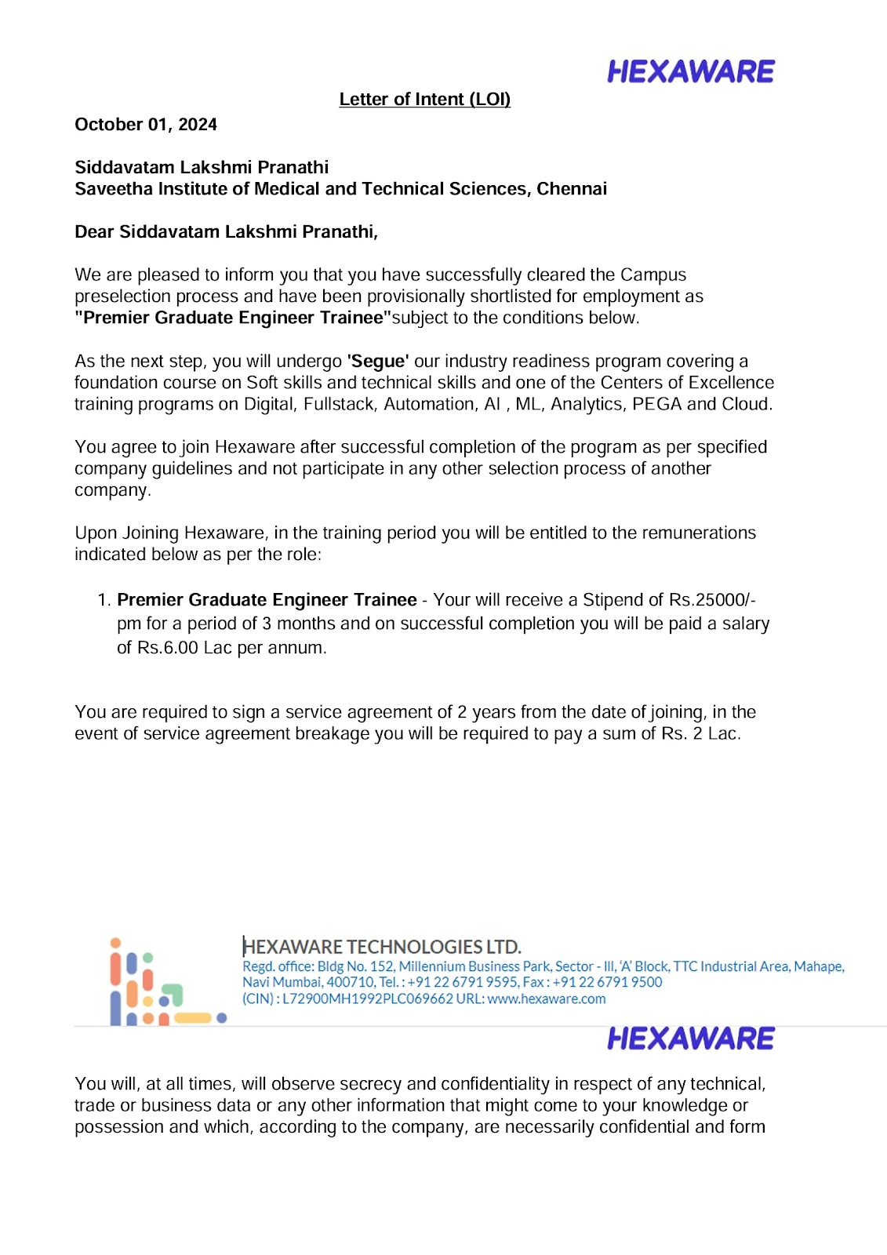
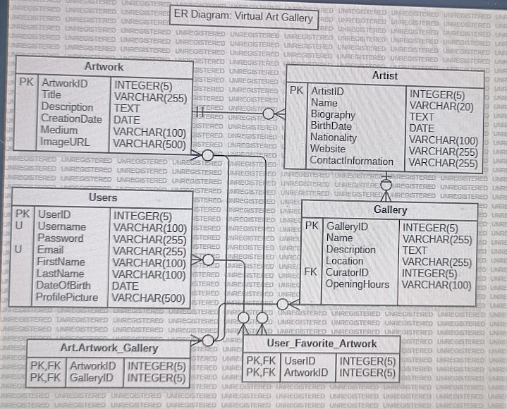
ATTACHMENTS

